Slide 1
ERL TELECOMS SERVICES LIMITED
Employee Induction Program

Slide 2
OBJECTIVES
Officially welcome you to ERL Telecoms Services Limited
Have a common understanding of the company
Clarify first steps on your journey

Slide 3
Contents
Company profile
Work Policies
Code of ethics and Professional Conduct
Personal Appearance and Dress code
Attendance Policy
Leave Policy
Training and Development
Performance Appraisal
Workplace Harassment
Environment, Health and Safety.
Safety Rules
Fire Procedure
Fire Precautions

Slide 4
Company Profile
ERL Telecoms Services Limited is a leading service provider in the Telecommunications industry, with substantial global capabilities and specific local expertise to offer our clients efficient and standardized ICT solutions.
Our strength lies in our ability to create innovative products and solutions for telecoms, banking, micro-financing and insurance platforms, offering unique products and services for our clients.
We develop path breaking products by utilizing our in-depth knowledge and understanding of telecoms platforms and customer needs, combining Business Intelligence with Credit rating and Decisioning systems to obtain unique insights into customer needs.
Some of our key products are Emergency Airtime Credit Advance, Smart Phones financing program, Mobile Insurance, etc.

Slide 5
WORK POLICIES

Slide 6
CODE OF ETHICS AND PROFESSIONAL CONDUCT
Inclusion- ERL Telecoms Services Limited welcomes and supports people of all backgrounds and identities. This includes, but is not limited to members of any sexual orientation, gender identity and expression, race, ethnicity, culture, national origin, social and economic class, educational level, colour, immigration status, sex, age, size, family status, political belief, religion, and mental and physical ability.
Consideration- At ERL Telecoms Services Limited, we depend on each other to produce the best work we can as a company. Your decisions will affect clients and colleagues, and you should take those consequences into account when making decisions.
Respect- As humans, we won't all agree all the time, but disagreement is no excuse for disrespectful behaviour. ERL Telecoms Services Limited believes that an environment where people feel uncomfortable or threatened is not a productive or creative one.
Good choice of words Employees must always conduct themselves professionally. Be kind to others. Do not insult or put down others. Harassment and exclusionary behaviour aren't acceptable at ERL Telecoms Services Limited. This includes, but is not limited to: - Threats of violence. - Discriminatory jokes and language. - Sharing sexually explicit or violent material via electronic devices or other means. - Personal insults, especially those using racist or sexist terms. - Unwelcome sexual attention. - Advocating for, or encouraging, any of the above behaviour.
Diversity- We can find strength in diversity. Different people have different perspectives on issues, and that can be valuable for solving problems or generating new ideas. Being unable to understand why someone holds a viewpoint doesn’t mean that they’re wrong. At ERL Telecoms Services Limited, we focus on resolving issues and learning from our differences.

Slide 7
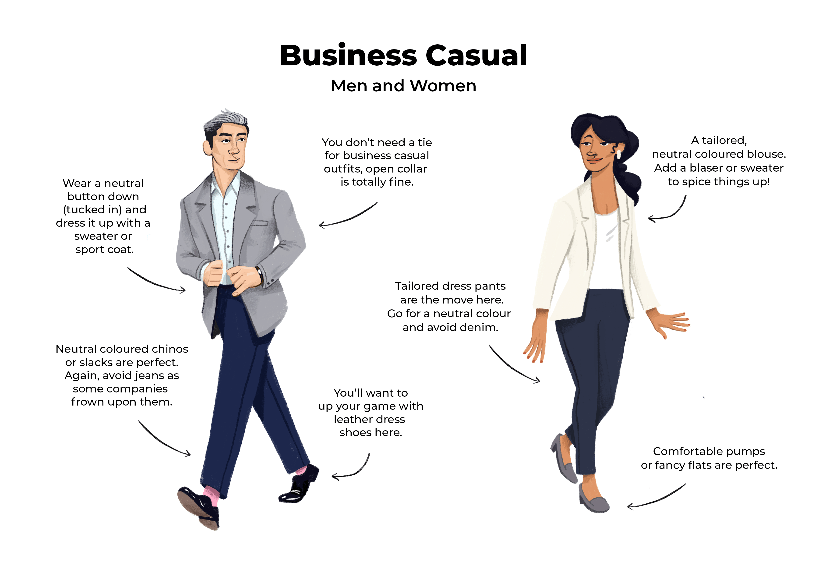
PERSONAL APPEARANCE AND DRESS CODE
Our dress code is business-casual. A smart and professional appearance is vital at all times. All employees must be well groomed and dressed appropriately for our business and for their position in particular. Employees must maintain exemplary appearance and professional conduct at all times when representing the company (during and after office hours).
Generally, clean, neat clothing is acceptable. However, torn jeans or other torn clothing and tee shirts with inappropriate verbiage or pictures are not appropriate business casual attire.
GENTLEMEN
Sport coat or casual blazer (optional)
Collared shirt or casual button-down
Tie (optional)
Casual slacks like khakis or chinos
Belt
Dress shoes, loafers or nice boots with socks
LADIES
Collared or non-collared blouse
Slacks (at least three-quarters length)
Dress or skirt (at or below the knee)
High heels, dress boots or flats
Modest jewellery
Accessories such as printed scarves

Slide 8
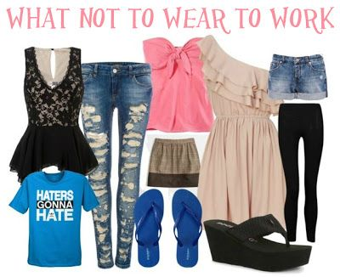
What Is NOT Business Casual
The following are considered inappropraite working attire-
Slippers of any sort
Spaghetti-strapped shirts and blouses
Sleeveless shirts (Men)
Tank tops or revealing shirts
Mini skirts
Sheer clothing
T-shirts with inappropriate or offensive gestures or advertising

Slide 9
ATTENDANCE POLICY
Attendance is a key factor in job performance. Punctuality and regular attendance are expected of all employees.
A. Hours Of Work
The work week for ERL Telecoms Services Limited is generally Monday through Friday (excluding public holidays published in gazettes), with normal operating hours from 8am to 4pm.
All employees must clock in and out using the biometric attendance tracking system.
Absenteeism generally refers to a circumstance in which an employee is habitually absent or not present at work during a normally scheduled work hours. An employee’s absences may be either scheduled or unscheduled.
Scheduled: Absences typically scheduled in advance include vacation, medical appointments and other events which cannot be scheduled outside of regular work hours.
Unscheduled: Absences typically occur as a result of illness, family emergencies, transportation emergencies, family member illness and/or death, and household emergencies such as flooding.
Excessive absenteeism is defined as three (3) or more unexcused absences in any ninety (90) day period.

Slide 10
ATTENDANCE POLICY
Excused And Unexcused Absences
Excused: Absence scheduled and approved by the employee’s manager in advance. Unscheduled absences for illness, family member illness or death, and similar unanticipated circumstances may also be treated as “excused” when an employee’s manager has given approval. Typically there may be no disciplinary consequence for an excused absence, unless the employee is habitually absent.
Unexcused: Absence that is not approved by an employee’s manager or embraced in the employer’s policies and procedures. This is grounds for disciplinary action.
If an employee is required to be absent from work, he/she must notify his/her supervisor and the Human Resources Department at least two days in advance and no later than one hour before the start of the scheduled workday. In the event of an emergency, notification must be sent as soon as possible. This will enable the Company make proper arrangement for replacement of the employee during the period of absence.
Queries shall be issued to any employee that reports late to work (more than three times in a month) and persistent late coming shall attract severe disciplinary actions.
Where an employee demonstrates the traits of a habitual late comer, the same disciplinary measures for absenteeism shall apply.
B. Overtime
ERL Telecoms Services Limited may from time to time require you to work overtime without extra pay if required by the workload or circumstances.

Slide 11
LEAVE POLICY
Annual Leave:
This runs from 1st January to 31st December every year and can be accrued to only the first quarter of the next year.
Comprises 22 days excluding weekends and public holidays. Employees are only entitiled to leave proportionate to the part of year they have worked
Confirmed employees that have worked for a year are eligible.
Must be planned with line manager ad included in the approved departmental leave plan at the beginning of the year.
Leave allaowance will be prorated accordingly.
Sick Leave:
Comprises 12 working days.
Medical certificate justifying the absence must be submitted within 48 hours.
Employee must contact his/her supervisor within 24hours of being absent from work or on medical leave.
Maternity Leave:
Comprises 12 weeks.
A confirmed employee will be paid fully salary.
An intern/ unconfirmed employee proceeding on maternity leave shall be treated as unpaid and will not count towards the satff probation or internship period.

Slide 12
LEAVE POLICY
Examination Leave:
Comprises 10 working days.
Compasionate Leave:
Comprises 7 days.
Casual Leave:
This is granted strictly at the discretion of management and can only be accessed at the exhaustion of other annual leave.
Additional days requested will be deducted from Annual Leave.
Can be utilized for-
Serious illness or death of a member of the immediate family. Immediate family is defined as father, mother, spouse, child, or where the employee is the next of kin.
Employee's wedding and wedding of children.
Any other reason, at the discretion of management.
An employee may be granted up to 7 days in a year.

Slide 13
TRAINING AND DEVELOPMENT
It is the firm conviction of ERL Telecoms Services Limited that an integral part of a company’s culture is commitment to training of employees.
a. The company will communicate the training systems and programs available.
b. It is the employee’s responsibility to comply with the training requirements for his/her job position.
We have established regular training programs to enable employees acquire competencies necessary to perform their jobs and advance throughout their careers. Courses that are part of job training are compulsory and failure to complete them successfully or have a 70% pass may hinder promotion opportunities.
However, if an employee identifies a training program which isn’t on the company’s schedule, but pertinent to their job efficiency, he/she should communicate with their Line Manager and Human Resources. Kindly note the employee will bear 10% of the training cost.
Training courses can be residential or non-residential as determined by the job requirement and/ or Management from time to time. In some cases where an employee is attending a course outside his/her place of employment, the company will provide accommodation, feeding and transportation.

Slide 14
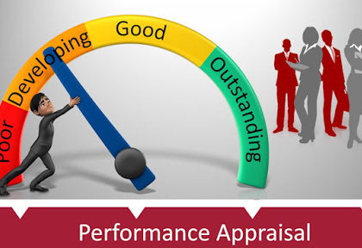
PERFORMANCE APPRAISAL
Members of staff are appraised at least twice a year or as may be appropriate. At an appraisal interview, each staff is expected to comment on the appropriateness of their job description and to suggest possible amendments. The appraisal is a combination of a written and a verbal evaluation. Appraisals provide insight and feed back to both the Company and the individual to ensure that each employee is realizing his or her potential.
During the probation period, an employee will be evaluated at 3 intervals- 2,4 and 6 months respectively. The purpose of the Performance Evaluation is to provide feedback to the Employee that will allow him/her to improve performance.
Appraisals are motivational tools that aid employees know their performance rating. It also reveals improvement points for the company and individuals.

Slide 15
WORKPLACE HARASSMENT
Harassment based on sex, marital status, nationality, religion, disability, ethnic or national origins will not be tolerated. Other forms of prohibited harassment include, but are not limited to, discriminatory intimidation, insult, and ridicule, unwanted sexual advances, offensive comments, jokes, innuendo, offensive objects, pictures, or other graphic material, where:
The conduct has the purpose or effect of creating an intimidating, hostile, or offensive work environment;
The conduct has the purpose or effect of unreasonably interfering with an individual’s work performance; or
The conduct otherwise adversely affects an individual’s employment opportunities.
Any employee who feels that he or she had been subjected to harassment of any kind or form has the following responsibilities:
Tell the person who is bothering you to stop.
Make a record of the incident and any witnesses.
Report the incident immediately to your supervisor, manager and the HR department.

Slide 16
ENVIRONMENT, HEALTH AND SAFETY
All employees are always required to be security conscious .
All staff must wear their identification tags when on duty.
All employees are required to be aware of the position and state of all equipment in their area of operation.
Report any missing or incomplete equipment to your immediate supervisor.
Make sure all safes; door locks and other entrances are securely locked before leaving the premises.
Report any suspicious individual within or around the company premises to security.
Employees shall be held responsible for the activities of their visitors.

Slide 17
SAFETY RULES
No person under the influence of alcoholic beverages or narcotic substance, illegal drugs is permitted at work.
Inform the supervisor of any prescribed medication taken during the working hours.
Playing around or kidding around, practical jokes and other types of unserious behavior are not tolerated on the job.
Tools, machinery and equipment must be kept in their proper places.
Tools and equipment must be right for the job and in safe condition. If damaged, report immediately to your supervisor/line manager and fill the incidence report form. This form must be submitted within 24hours to Human Resources department.
Post warning/danger signals when necessary.
Use stapler, scissors, paper cutter, knives, and letter openers with care as they can inflict serious cuts and puncture wounds.
Hold items such as scissors and letter openers with handles and blade should not be thrown or tossed.

Slide 18
SAFETY RULES
Never stand on a swivel chair or makeshift device to reach high places.
Approach doors that open towards you from the side.
Open doors into the office carefully and do not barge-in as there may be someone behind the door.
Never stand in front of a door that opens toward you.
Never open a file drawer with another drawer out.
Always close file drawer and desk drawer when not in use.
Cords, which are worn or have exposed wire should be reported for repair

Slide 19
FIRE PROCEDURE
In the event of fire, observe the following procedure:
Know the location and the methods of operating the fire fighting equipment in the building.
Know the primary and secondary escape routes to use
Be familiar with survival techniques. In case the fire traps you, stay low to the ground floors.
Never use an elevator to escape a fire (use the stairway).
Never overload an electrical circuit.
Do not attempt to repair electrical or mechanical equipment without de-energizing it.

Slide 20
FIRE PRECAUTIONS
Each person shall learn the location of the extinguishers in his/her workplace
Any time the fire extinguisher is used, it must be reported to the HR Manger or the safety officer.
No smoking will be permitted within the office environment or while on duty.
Report immediately any conditions that are likely to cause a fire.
The use of gasoline and other flash fuels for cleaning purposes is strictly prohibited.
Do not leave oily rags and waste on locker or on machinery as they catch fire easily.
Always shut off the engine of vehicles before uplifting fuel or welding materials.

Slide 22
Disclaimer: This presentation is not intended to be all inclusive. Kindly refer to the employee handbook for more information. Also contact Human Resources for clarity where necessary.

