Slide 1
Failure To Work On Customer’s Request.

Slide 2
WHY NPC WAS ISSUED
Customer sent a request on “update delay” for an Item which was first assigned to me by Ebele.
I erroneously re-assigned the ticket back to inbox.
The error was noticed by Manafa who notified Chioma to follow up.
My Attention was called to the first error I committed.
But I still failed to follow up with who the request was given to ensure it was worked on. I failed to correct my error.
Apparently, the customer has two similar request which we mixed up with this particular one.

Slide 3
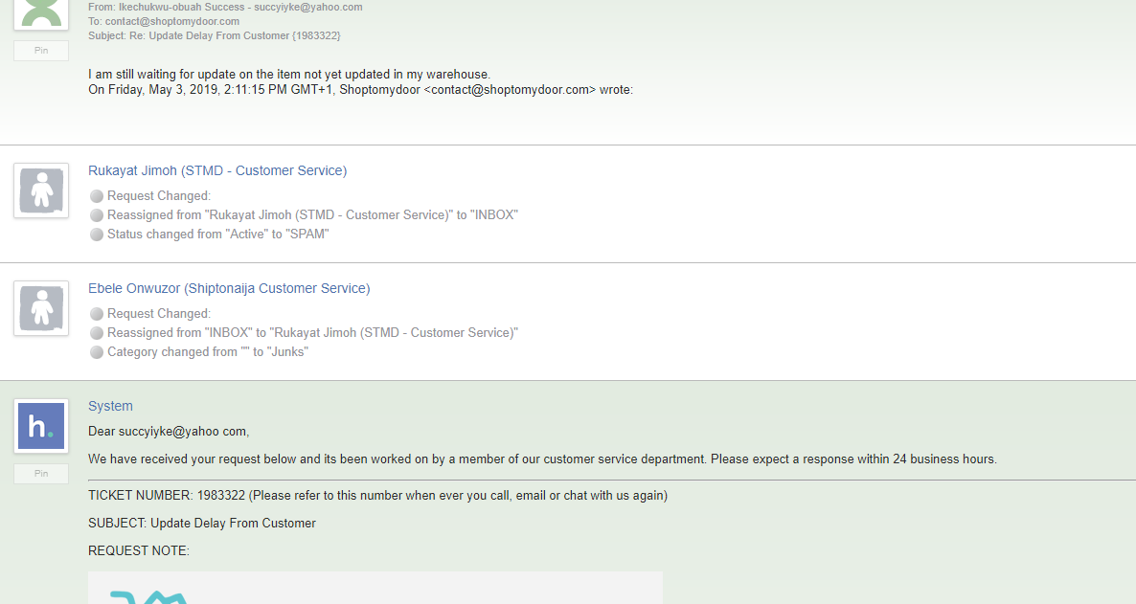
Shipment assigned to me, and erroneously assigned to Inbox.

Slide 4
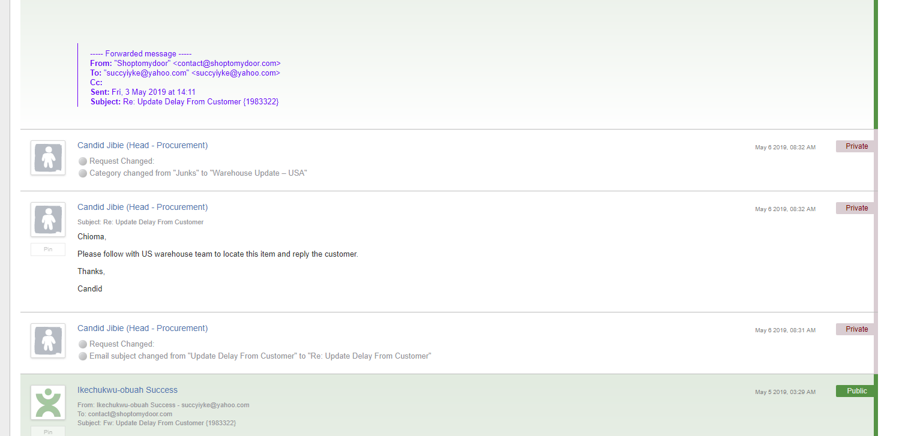
The point it was noticed and was given to someone else to work on.

Slide 5
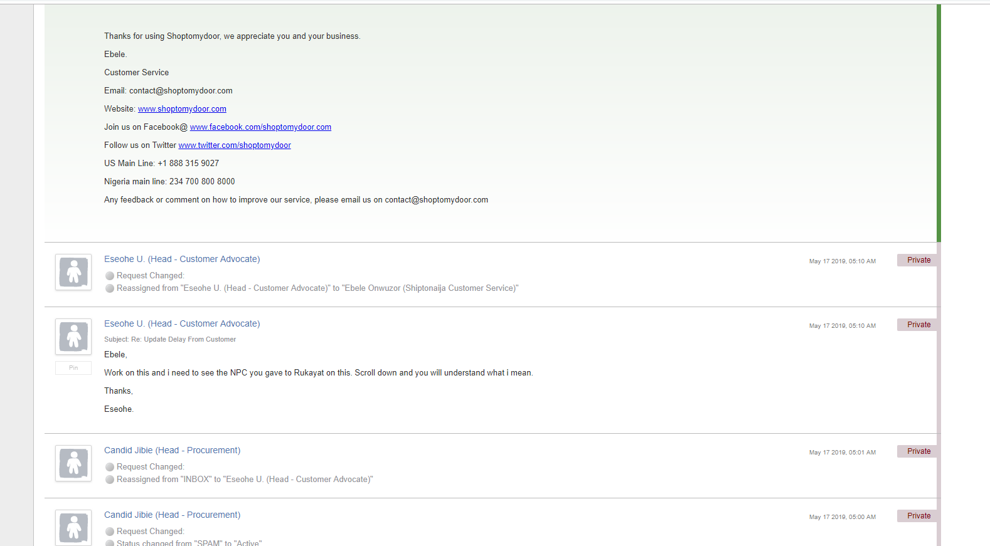
THE REQUEST WAS NOTICED AGAIN NOT WORKED ON AND I WAS ISSUED AN NPC

Slide 6
WHY IS IT BAD FOR THE CUSTOMER
The customer will be uneasy as he ordered for an Item and he was yet to receive an update on it.
This might lead to delay in customer receiving the item.
Which might in turn defeat the purpose of the customer buying the item in the first place.

Slide 7
WHY IS IT BAD FOR THE COMPANY
It Makes us look like we do not know what we are doing.
The customer might not trust us again because we received his item and did not notify him.
The customer might go to Social Media to vent which is a negative publicity.

Slide 8
WHAT WAS DONE TO RECTIFY THE ISSUE
It was finally worked on by a third party.
Apparently the item was not delivered to us in the first place.
We could have noticed this if the request was worked on immediately and the customer can contacted his merchant for a solution on time.

Slide 9
RECOMMENDATIONS SO AS TO AVOID FUTURE OCCURRENCE.
We should always critically analyze each ticket to avoid mix up.
We should always ensure we follow up.

Slide 10
WHAT SHOULD BE OUR PRIORITY?
Timely response and resolution should be prioritized.

