Slide 1
DELAY IN RESOLVING CUSTOMER’S ISSUE

Slide 2
WHY NPC WAS ISSUED
Customer contacted us on Friday to work on her invoice which I did.
On looking at my queue on Saturday, she came back complaining about hazmat charge for items updated in her warehouse.
I called her to explain the charge to her.
She stated the items are not hazardous, when I googled what was updated, the pictures seen were plant and fruit.
I told her will we do our verification and get back to her.
I sent her a mail after the conversation, I also told her I will forward the request to the unit in charge and get back to her on the mail sent.
When boss reviewed the ticket, have made complained of the phrase used “your request has been forwarded to the unit in charge”.
We should have request worked on immediately and not keep customers waiting. All issues have to be resolved on first contact.

Slide 3
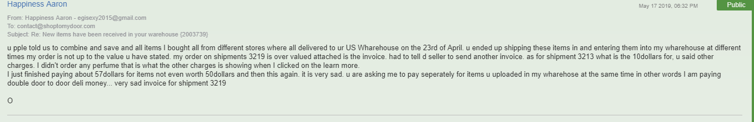

Slide 4
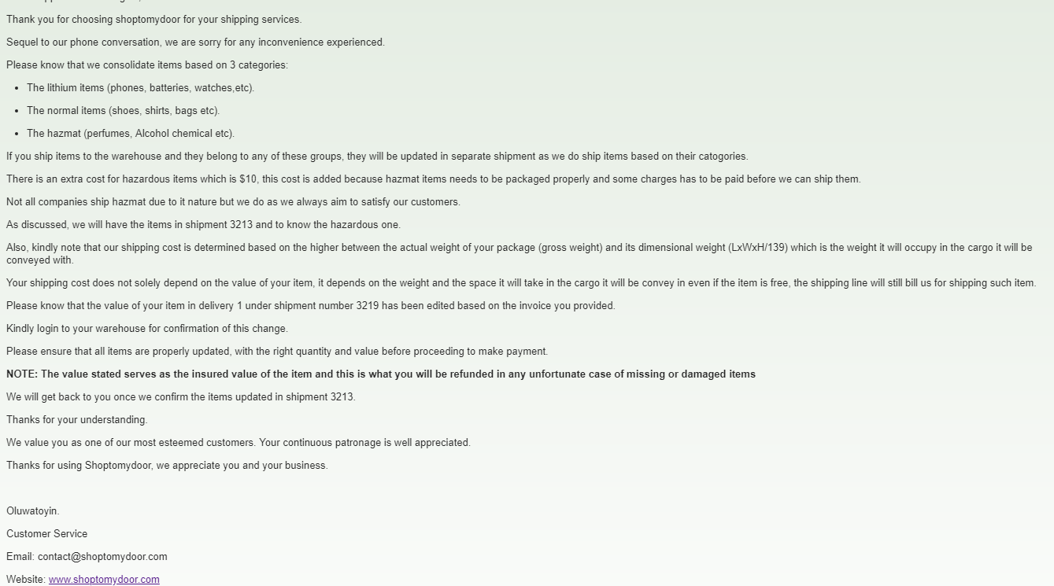

Slide 5
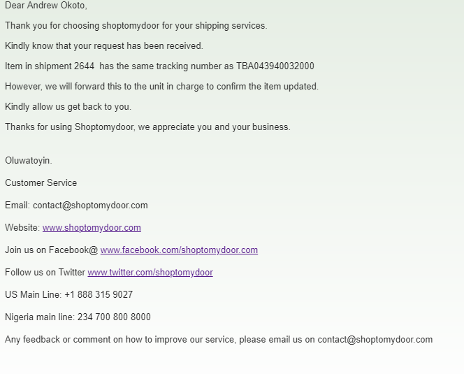
This is for another customer I gave the same response

Slide 6
WHY IS IT BAD FOR THE CUSTOMER
Issues have to be resolved immediately, customers might need their items urgently.
Customers will be delayed in making payment for their shipments which might also result in storage charge.

Slide 7
WHY IS IT BAD FOR THE COMPANY
Customers does not like to be kept waiting before an issue is resolved. If they are not satisfied, we might loose them.

Slide 8
RECOMMENDATIONS SO AS TO AVOID FUTURE OCCURRENCE.
Issues should be resolved timely.
If need be, you can leave your seat and go to the unit in charge to have the issue resolved immediately

Slide 9
WHAT SHOULD BE OUR PRIORITY?
Always ensure that the company’s core value is adhered to by providing every customer a stress free service delivery

